Slide 1

Chapter 2
The Internet, the Web, and Electronic Commerce
张元平 13594006339
Notes:
This chapter introduces you to skills and concepts you need to be prepared for the ever-changing digital world including impact, hardware, and applications.

Slide 2
Learning Objectives
Explain the origins of the Internet and the web.
Explain how to access the web using providers and browsers.
Compare different web utilities including filters, file transfer utilities, and Internet security suites.
Compare different Internet communications, including social networking blogs, microblogs, webcasts, podcasts, wikis, e-mail, text messaging, and instant messaging.
Describe search tools, including search engines and specialized search engines.
Describe how to evaluate the accuracy of information presented on the web.
Identify electronic commerce, including B2C, C2C, B2B, and security issues.
Describe cloud computing, including the three-way interaction of clients, Internet, and service providers.
Discuss the Internet of Things (IoT) and the continuing development of the Internet to allow everyday objects to send and receive data.
Notes:
Review the Learning Objectives with students to help them understand what they need to get from the chapter.

Slide 3
Introduction
The Internet.
Interconnected mesh of computers and data lines.
Connecting millions of people and organizations.
Foundation of the digital revolution.
Allowing people around the world to share words, images and any digital file almost instantaneously.
The Web.
Provides a multimedia interface to Internet resources.
To be effective and efficient.
End user awareness of the resources available on the Internet and the Web.
Notes:
This chapter provides a background on the Internet, digital revolution, the Web, and how to be effective and efficient with technology.

Slide 4
The Internet and the Web
The Internet. Large global network connecting smaller networks all over the globe.
The Internet launched in 1969.
The United States funded a project to develop a national computer network.
ARPANET (Advanced Research Project Agency Network). （ENIAC）
World Wide Web or W W W was introduced in 19 91.
The Internet and the web are NOT the same.
The Internet is the physical network.
The web is a multimedia interface to the resources available on the Internet.
Notes:
The Internet (key term) is the most developed network system currently in use; connects people all over the world
The Internet originally started in 1969 when US funded a research project (ARPANET—Advanced Research Project Agency Network) (key term)
World Wide Web (Web) is a part of the Internet – not the Internet; introduced in 1991 by consortium in Switzerland
Originally started as research and text-based network to exchange research ideas from university to university
Internet is the actual physical network comprised of wires, cables, satellites, and rules
Being connected to the network is often referred to as being online (Key Term)
The Web is a multimedia interface to resources available on the internet

Slide 5
Web
Web 1.0.
1st generation.
Linking existing information focus.
Search programs were created.
Web 3.0.
Identifies relationships between data.
Personalized content creation for users.
Web 4.0.
Called the mobile web.
Similar to Web 3.0 but includes information from mobile devices.
Web 2.0.
Dynamic content creation.
Facebook is most common in Web 2.0.
Notes:
Web 1.0 (key term) – linking existing information
Web 2.0 (key term) – more dynamic content creation and social interaction (Facebook)
Identifies relationships between data
Siri and Google Assistant
Web 3.0 (key term) – computer-generated information requiring less human interaction
Web 4.0 (key tern) – similar to Web 3.0, but also includes information gathered from mobile devices.

Slide 6
Common Internet Uses
Communicating.
Shopping.
Searching.
Education or e-learning.
Online Entertainment.
Notes:
Most common Internet uses are:
Communicating – most popular Internet activity. Exchange e-mail, photos, videos
Shopping – fastest-growing applications
Searching - using virtual libraries.
Education or e-learning (Key Term) – take classes remotely from almost any location and any subject
Entertainment – music, movies, magazines, computer games
See the Making IT work for you for Online Entertainment

Slide 7
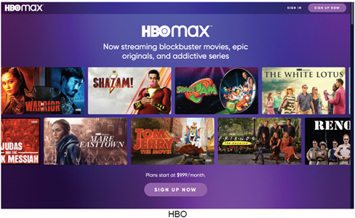
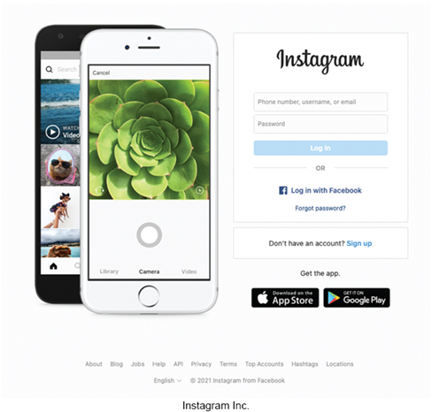
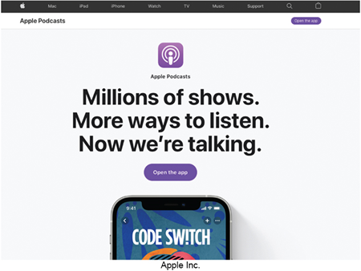
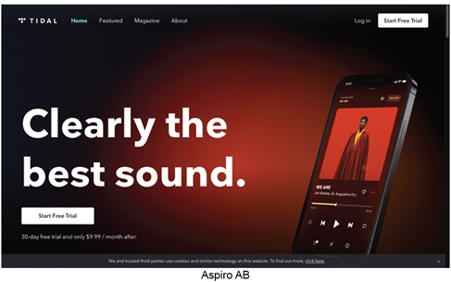
Making IT Work for You – Online Entertainment
Online options for TV, movies, music, books, social media, news feeds.
Hulu, Amazon Prime, Netflix, Amazon Kindle, C N N, Instagram, Tidal, HBOMax, Apple Podcasts.
Jesse33/Shutterstock; Annette Shaff/Shutterstock; Castleski/Shutterstock; Roman Psyshchyk/Shutterstock
Notes:
Many users are no longer subscribing to cable or satellite services. Instead they are using pay-as-you-go services such as Hulu, Netflix and Amazon Prime to watch movies and their favorite TV episodes.
Pandora and Spotify for online music
Digital books allow you to read several books at a time on different devices.
News feeds such as Feedly.com allow you to search for news sources by publisher or topic.
And there is also Pay-as-you-go programs available

Slide 8
Internet Access Providers
Internet Service Provider (I S P).
Common way to access the Internet.
Provide a path to access the Internet.
Use digital subscriber line (D S L), cable, and/or wireless connections.
Most common providers.
Verizon, Comcast, Sprint, T-Mobile, AT&T.
Microsoft Corportation; Applie, Inc.
Notes:
The common way to access the Internet is through a provider
Internet Service Providers (ISPs) (key term) - already connected to the Internet -- furnish a pathway for other users
Most commonly used ISPs use telephone lines, cable (key term) and / or wireless connections
Typical providers include:
Verizon, Comcast, Sprint, T-Mobile and AT&T
Discussed in Chapter 8 - ISPS connect using connection technologies
DSL, Cable, Wireless

Slide 9
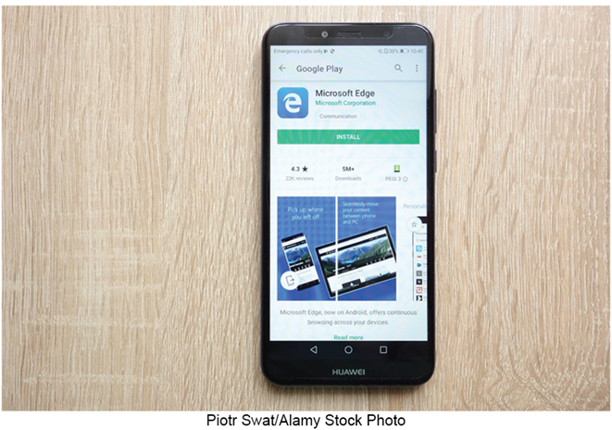
Browsers（HTML）
Provide access to web resources.
Allow you to explore the web.
Connect to remote computers.
Uncomplicated interface to the Internet.
File transfer.
Display many varieties of multimedia.
Popular Web browsers include:
Mozilla Firefox.
Apple Safari.
Microsoft Edge.
Google Chrome.
Indiaforte/Alamy Stock Photo
Notes:
Browsers (key term) programs that allow you to explore the web
Navigate, search for information and communicate using the web

Slide 10
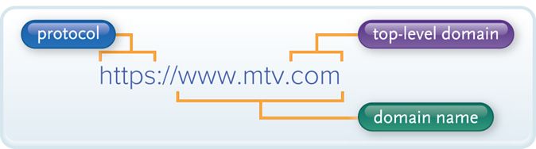
U R Ls (http://www.swu.edu.cn)
Uniform Resource Locator.
Location or address of resource.
https is the most common for web traffic.
Two parts.
Protocol.
Rules for exchanging data.
Domain name.
Where resource is located.
Figure 2-4
Notes:
Use URL (uniform resource locator) (Key Term) to connect to other resources. URL is the address (key term) and contains two parts.
Two parts to URL:
protocol (Key Term), rules for exchanging data between computers (usually http://);
domain name (Key Term) – specific address where the resource is located
Many URLs have additional parts specifying directory paths and file names.

Slide 11
Top-Level Domain (T L D)
.com
Commercial.
.net
Network.
.edu
Educational.
.org
Organization.
.gov
Government.
.mil
US Military.
Notes:
TLD or Top-level domain (key term), also known as the web suffix (key term) identifies the type of organization

Slide 12
H T M L and Hyperlinks
Hypertext Markup Language.
Markup language for displaying web pages.
Browsers interpret H T M L commands.
Display document as a web page.
Hyperlinks or links.
Connect to other web pages.
Text files.
Graphic images.
Audio and Video Clips.
Notes:
Browsers Interpret the HTML (key term) codes and formatting instructions and displays the document as a web page (term term)
May contain
Hyperlinks (Key Term) or links (key term) -- allow users to quickly connect to other pages or web sites
Graphics
Text
Multimedia elements

Slide 13

Interactive Web Sites
Technologies used to provide highly interactive and animated websites.
JavaScript. (VUE) view
P H P. （微服务）
Cascading Style Sheets (C S S). （CSS3+H5)
Mobile Browsers.
George Dolgikh/Shutterstock
Notes:
JavaScript (key term) – language used with HTML documents to trigger interactive features such as opening a new browser
PHP (key term) – language also used the HTML documents to improve website’s interactivity. However, PHP executives on the website’s computer, JavaScript executes on the user’s computer. Cascading Style Sheets (key term) – files referenced that control the appearance of a web page giving them consistent look for presentation.
Mobile Browsers (key term) – designed to run on portable devices. Contain special navigational tools for convenience to pinch and stretch

Slide 14
Web Utilities
Specialized utility programs that make using the Internet and web safer and easier.
Filters.
File Transfer Utilities.
Internet Security Suites.
Notes:
Web utilities (key term) are specialized utility programs that make using the Internet and web easier and safer
The utilities we will discuss are:
Filters
File Transfer Utilities
Internet Security Suites

Slide 15
Filters
Block access to selected sites.
Set time limits.
Monitor total time spent on the Internet and at individual web sites.
Net Nanny.
Qustodio Parental Control.
Circle with Disney.
Symantec Norton Family Premier.
Bob Dormon/theregister.co.uk
Notes:
Filters (key term) – block access to selected sites.
Filters can also monitor use and generate reports detailing the total time spent on the Internet and specific sites.
Best know filters
Net Nanny – www.netnanny.com
Qustodio Parental Control – www.qustodio.com
Circle with Disney – meetcircle.com
Norton Online Family – onlinefamily.Norton.com
McAfee Family Protection – www.mcafeefamilyprotection.com

Slide 16
File Transfer Utilities
Upload and download files to and from the Internet.
Downloading.
Uploading.
Three popular types of programs.
Web-based file transfer services.
Bit-Torrent.
File transfer protocol (F T P) / Secure file transfer protocol (S F T P).
Notes:
Also referred to as downloading (key term) – receiving a file from the Internet and uploading (key term) copying a file to the Internet
Web-based file transfer services (key term)
uses web browser to upload and download files
Dropbox.com is a widely used service
BitTorrent (key term)
distributes file transfers across many computers for more efficient downloads
File Transfer Protocol (key term) and Secure File Transfer Protocol (key term) (FTP & SFTP)
copy files to and from your computer to the Internet
used for uploading changes to a website
good for transferring large files

Slide 17
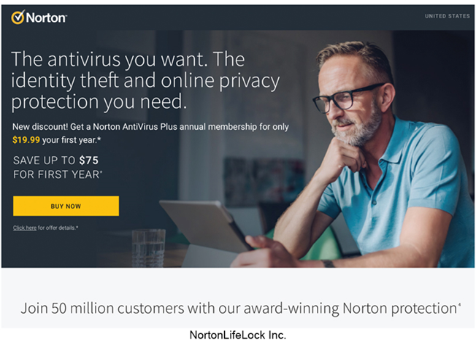
Internet Security Suites
Designed to maintain your security and privacy while on the web.
Two best known suites.
Symantec Norton Internet Security.
Bitdefender Internet Security.
Nortion
Notes:
Internet Security Suites (Key Term) – collection of utility programs designed to maintain your security and privacy while you are on the Web
Control spam
Protect against computer viruses
Provide filters
Suites are the most cost efficient way to go instead of buying each component separately.
McAfee Internet Security
Symantec Norton Internet Security

Slide 18
Communication
Communication is the most popular Internet activity.
Social Networking.
Blogs, Microblogs, Podcasts, and Wikis.
Messaging.
E-mail.
Notes:
Communication – most popular Internet activity:
Social Networking
Blogs
Microblogs
Podcasts
Wikis
Messaging
E-mail

Slide 19
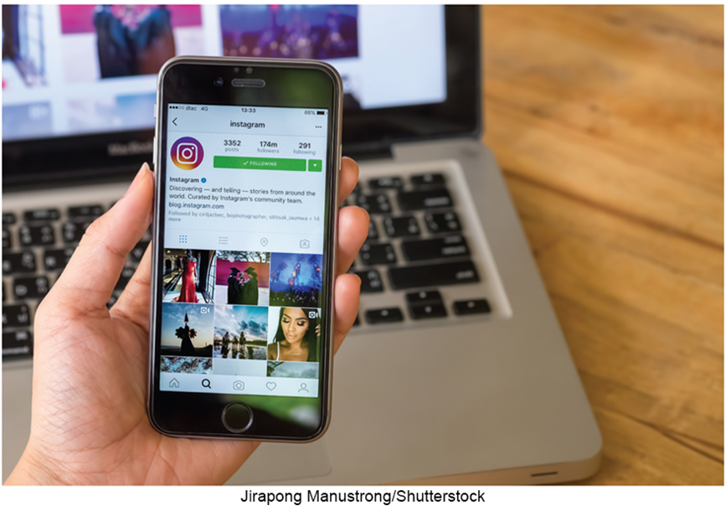
Social Networking
Connecting people and organizations that share a common interest or activity.
Common features.
Profiles.
Pages.
Groups.
Friends.
News feed.
Share settings.
ImageBROKER/Mara Brandl/Newcom
Notes:
Social Networking (Key Term)
One of the fastest growing uses of the Internet
Connecting individuals to one another
Common features in most all social networking sites:
Profiles (key term) – created by individuals to share personal information
Pages (key term) – created by companies to promote their business
Groups (key term) – communities of individuals who share a common interest
Friends (key term) – list of those you want to communicate with
News feed (key term) – first page you see after logging into the site
Share settings (key term) – settings you set determining who can see your posts

Slide 20
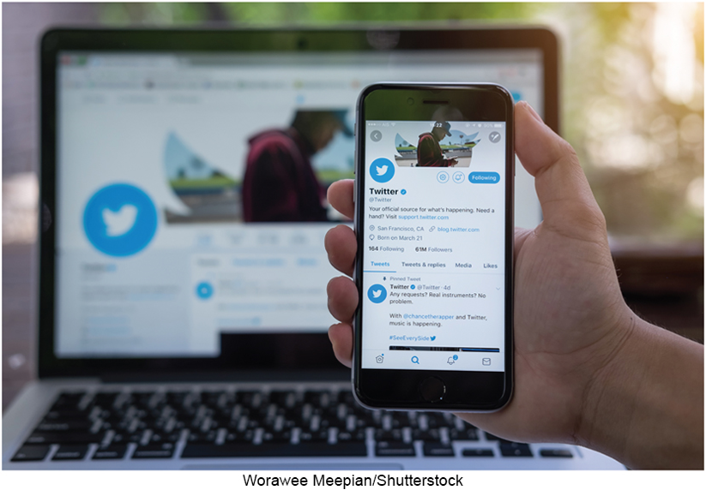
Blogs
Blogs.
Microblogs.
Annette Shaff/Shutterstock
Notes:
Blogs (key term) personal websites to keep in touch with family and friends
Online diaries
Blogger and WordPress
Microblog (key term) publish only short sentences
Twitter (key term) is the most popular
Tweet is a Twitter message

Slide 21
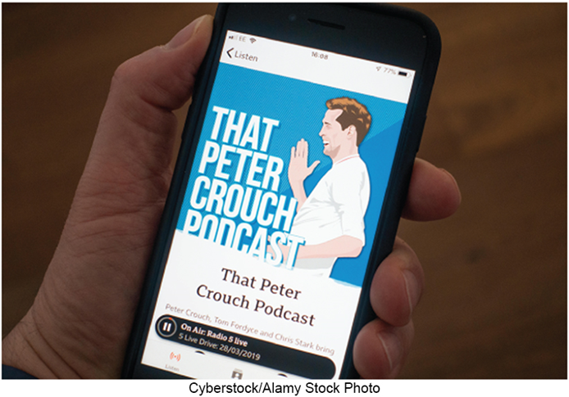
Webcast, Podcast, and Wikis
Podcast.
Delivered over the Internet.
Typically one audio program in a series of related podcasts.
Wiki.
Specially designed Web site.
Allows visitors to edit the contents.
Supports collaborative writing.
Apple
Notes:
Podcasts (key term) available on iTunes and are typically a series of programs
Wiki (key term) – website which is editable by users. Built on a community of interested people that build knowledge over time.
Wikipedia (key term) is an example of using a wiki as an online encyclopedia

Slide 22
Messaging
Text Messaging.
MMS.
Instant Messaging.
Notes:
Electronic messaging is a popular way to communicate quickly and efficiently with friends, family, and co-workers. This form of communication is particularly common on cell phones, where messages are short and informal, and instantaneous responses are the standard.
Text messaging – AKA SMS – fewer than 160 characters, short electronic message
MMS – Multimedia messaging service – images, video, sound
Instant Messaging – two or more people contact each other via direct, live communication. Facebook messenger, Google Meet, and WhatsApp are several examples.

Slide 23
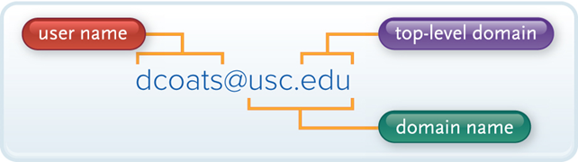
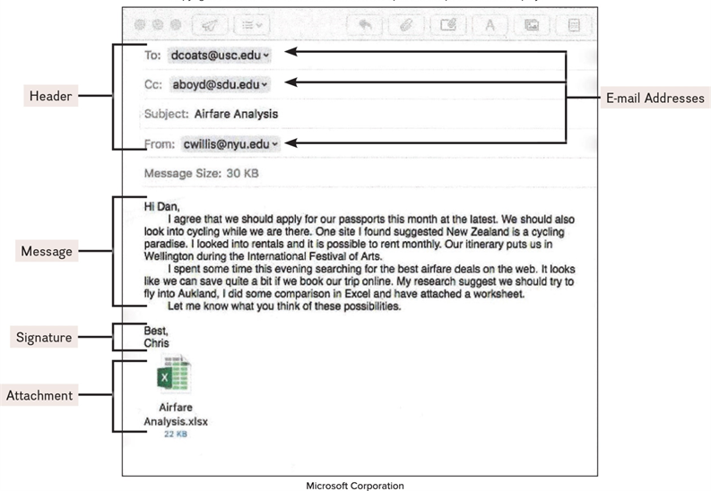
E-Mail
Transmission of electronic messages over the Internet.
Four basic elements.
Header.
Address.
Subject.
Message.
Signature.
Attachments.
Figure 2-16, Figure 2-17
Notes:
E-mail or electronic mail (Key Term)
Transmission of electronic messages over the Internet
Has four basic elements: header (key term), message (key term), signature (key term) attachments
Header contains:
Address (key term) – who the e-mail is going to.
Address (Key Term) has two parts
User name - identifies unique user or computer in the domain
Domain name (Key Term) - references a specific organization
Subject (key term) – topic of the message
Message: (key term) – letter
Signature: (key term) – information about the sender
Attachments: (key term) – documents and / or images you attach to the message

Slide 24
E-mail Systems
Client-based.
E-mail client.
Must be installed on computer.
Apple’s Mail.
Microsoft Outlook.
Web-based.
Webmail client.
No installation necessary – free.
Google’s Gmail.
Microsoft’s Outlook.
Yahoo!’s Yahoo! Mail.
Notes:
Client-based e-mail system (key term) – requires installation of an e-mail client (key term) on your computer. Examples are Microsoft Outlook and Apple’s Mail.
Web-based e-mail system (key term) – no email program on your computer, access from any computer through a Browser. Examples are Google Gmail, Microsoft Outlook, Yahoo! Mail

Slide 25
SPAM
Spam.
Unwelcome e-mail.
Computer viruses.
Destructive programs.
CAN-SPAM Act.
Antispam laws.
Spam Blockers/Filters.
Identify and control spam.
Notes:
Spam (Key Term) – unsolicited / unwelcome e-mail
Distraction, Nuisance
Computer viruses (Key Term) can also be attached to spam
Spam blockers (Key Term)/ Spam filters (key term) use a variety of different approaches to identify and eliminate spam
CAN-SPAM Act requires that every marketing related email provide an opt-out option
Tips to blocking spam:
Keep a low profile
Use caution when giving out your address
Don’t ever respond to spam
Use antispam and filter options

Slide 26
Search Tools
Search Services.
Operate websites.
Spiders.
Search Engines.
Assist in locating specific information.
Search Services | Site
Bing | www.bing.com
Duckduckgo | www.duckduckgo.com
Google | www.google.com
Yahoo! | www.yahoo.com
Content Evaluation.
Information on the web is often not reviewed to ensure accuracy.
Figure 2-18 Search Engines
Notes:
Specialized programs that assist you in locating information on the Web and the Internet
Search services (Key Term) operate web sites that help you locate information; they maintain the database that helps you get where you want
Special programs called spiders (Key Term) continually look for information and updated services
Search engines (Key Term) – assist you to locate specific information
Use keyword or phrase search; know “rules” i.e. use + or quotes to look for phrases rather than individual words
Content Evaluation (Key Term) – anyone can publish content on the web, therefore steps should be taken to review content for Authority, Accuracy, Objectivity, and Currency (timeliness)

Slide 27
Content Evaluation
Authority.
Accuracy.
Objectivity.
Currency.
Notes:
Content Evaluation – be sure to check the authority, accuracy, objectivity and currency

Slide 28
Electronic Commerce
Business-to-consumer (B2C).
Consumer-to consumer (C2C).
Business-to-business (B2B).
Notes:
Electronic commerce (key term) or E-Commerce (key term) is buying and selling over the Internet
Three basic types of electronic commerce: business to consumer; consumer to consumer; and business to business
B2C
C2C
B2B

Slide 29
Business to Consumer (B2C)
Sale of product or service to general public.
Fastest growing type of e-commerce.
Three most widely used B2C applications:
Online banking.
Financial trading.
Shopping.
Amazon.com is one of the most widely used B2C sites
Notes:
B2C (key term) is fastest growing type of e-commerce. Involves the sale of a product or service to the general public or end user.
Three types
Online banking
Financial trading
Shopping
Amazon.com is one of the most widely used B2C sites.

Slide 30
Consumer to Consumer (C2C)
Consumer-to-consumer e-commerce (C2C).
Individual to individual.
Web auctions.
Buyers and sellers seldom meet.
Bids are submitted electronically.
Online auction sites.
Notes:
Recent trend in C2C e-commerce (key term) involves individuals selling to individuals and is Web auctions (Key Term); similar to traditional auctions – no one sees each other
Buyers and sellers seldom meet face-to-face
Ask the students if they have ever used E-bay
Example auction sites include eBay, eBid, Etsy.

Slide 31
Business to Business (B2B)
Sale of a product or service from one business to another.
Primarily a manufacturer supplier relationship.
Notes:
Business to Business (B2B) (key term) involves the sale of a product or service from one business to another.
Example: A furniture manufacturer requires raw materials such as wood, paint, and varnish.

Slide 32
Security
Payment methods must be fast, reliable, and secure.
Provide a convenient way to submit buyers’ information.
Two options.
Credit card.
Fast and convenient.
Digital cash.
Internet’s equivalent to traditional cash.
Converts digital cash to currency through 3rd party.
Cryptocurrency uses public ledgers, known as blockchains, to record all transactions.
Notes:
A challenge is the payment for goods
Should be reliable, secure, and fast
Convenience
Electronic payment -- easy, secure payment method
Credit cards -- easier to work with, somewhat vulnerable to theft
Digital cash (Key Term)
Purchased from third party (usually a special bank); more secure than credit cards
Providers include Amazon, Google, Venmo, and PayPal
Cryptocurrency do not involve third party banks, examples include Bitcoin, Ethereum, Litecoin

Slide 33
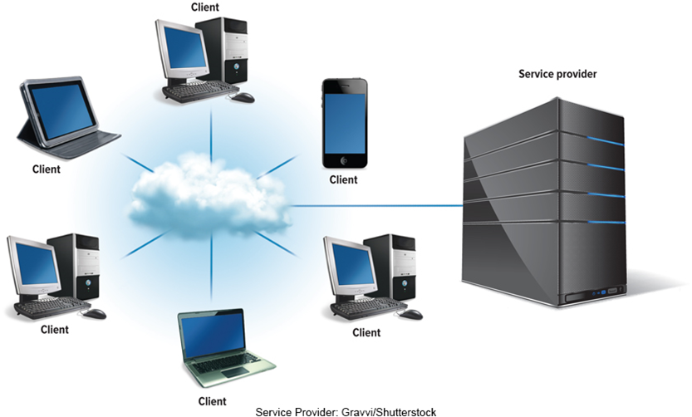
Cloud Computing
Shifts computing activities from users’ computers to computers on the Internet.
Frees end-users from owning, maintaining, and storing software programs and data.
Three basic components:
Clients (end-users).
The Internet.
Service providers.
Gravvi/Shutterstock
Notes:
Cloud computing (key term) Basic components include:
Clients: corporations and end-users who want access to data, programs, and storage anywhere and anytime a connection to the Internet is available
Internet – to provide the connection between the client and the provider
Service providers: organizations that are willing to provide (sometimes for a fee) access to software and storage
Two critical factors that determine the efficiency of cloud computing
The speed and reliability of the user’s access to the Internet
Internet’s capability to provide safe and reliable transmission of data and programs

Slide 34
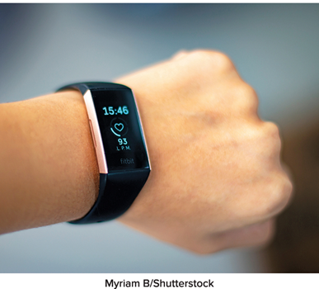
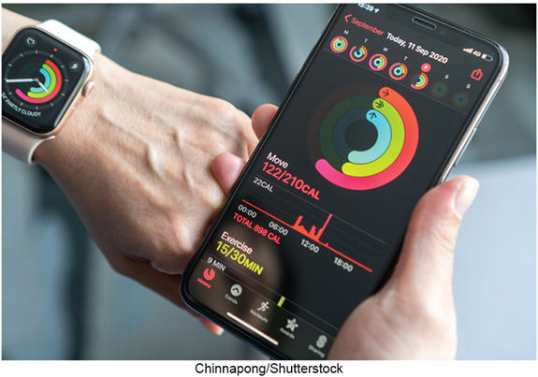
Internet of Things (IoT)
Continuing development of the Internet.
Allows objects embedded with electronic devices to send and receive data.
Smartphones.
Wearable devices.
Coffee makers.
Uses Web 3.0 Applications.
Myriaum B/Shutterstock, Denys Prykhodov/Shutterstock
Notes:
Internet of Things (IoT) (key terms) - continuing development of the Internet which allows objects embedded with electronic devices to send and receive data
Includes
Smartphones
Wearables
Coffee makers
Uses web 3.0 applications to sync devices with web applications

Slide 35

Careers in I T - Webmasters
Develop and maintain websites and resources.
Backup of company website.
Design and development of websites.
Work with the marketing team.
Increase site traffic.
Development of web promotions.
G-Stock Studio/Shutterstock
Notes:
Webmasters
Employers look for:
Bachelor’s or associate’s degree in computer science or information systems
Knowledge of common programming languages and web development software
HTML, CSS, and PHP are essential
Web Authoring knowledge
Good communication and organizational skills are essential
Salary in the range of $52,000 to $82,000

Slide 36
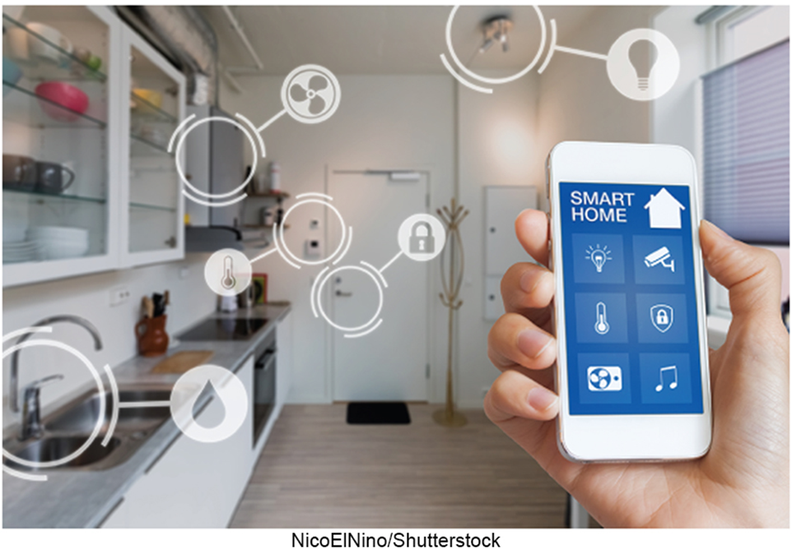
A Look to the Future
Home Smart Home.
MyCreative/Shutterstock
Notes:
Review the Look to the Future in the chapter.

Slide 37
Open Ended Questions
Discuss the Internet and web, including their origins, the four generations of the web, and the most common uses.
Describe how to access the Internet. What are providers? Define browsers, and discuss U R Ls, H T M L, C S S, JavaScript, AJAX, P H P, and mobile browsers.
What are Web utilities? Discuss filters, file transfer utilities, and Internet security suites.
Discuss Internet communications, including social networking, blogs, microblogs, podcasts, wikis, client-based and web-based e-mail, and messaging.
Define search tools including search services. Discuss search engines. Describe how to evaluate the content of a web site for Authority, Accuracy, Objectivity, and Currency.
Describe electronic commerce, including business-to-consumer, consumer-to-consumer, and business-to-business e-commerce, and security.
Discuss the Internet of Things (IoT). Describe how Fitbit and Apple’s Health App are examples of how an IoT device can interact with a Web 3.0 application.
What is cloud computing? Describe the three basic components of cloud computing.
Notes:
Have students turn to the end of Chapter 2 in their textbooks to view the same “Open-Ended” questions/statements

Slide 38
End of Main Content
© McGraw Hill LLC. All rights reserved. No reproduction or distribution without the prior written consent of McGraw Hill LLC.

